Slide 1
Brain Teaser
What number comes next? 2, 2, 4, 12, 48, ___
Billie was born on December 28th, yet her birthday always falls in the summer. How is this possible?

Slide 2
Answers
1 - 240. To get the number, multiply the previous number in the series by its position. 48 is in the 5th position, so 48 × 5 = 240
2 - Billie lives in the southern hemisphere.

Slide 3
Stock Competition Update
Who’s Hot : Alec - Netflix
Benjamin - Facebook
David – Zynga (short)
Who’s Not: Patrick - Apple
Kevin - Apple
Spandana- Apple

Slide 4
Current Events

Slide 5
Numbers to Know
Commodities
Oil
$85.09
Gas
$3.59
Gold
$1710.70
Silver
$31.58
Indexes
S&P 500
1392.80
DJIA
12936.30
Hang Seng
22099.80
Notes:
Oil/gas/gold/silver all down
S&P & DJIA
DJIA lowest since august (down 2.41%) S&P (down 2.49%)
fiscal cliff $607 billion tax increases and federal spending cuts in January (biggest plunge ever for the dow the day after an election)
Fucking time warner went up 2.5%

Slide 6
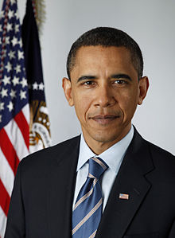
Elections 2012
Notes:
Obama to serve a second term
Affordable Care Act providing near universal health care and further deepening government debt to be in effect in 2014
Dodd-Frank financial reforms to be implemented
Bush tax cuts (supposed to end in 2010, but obama extended them mid-recession)
pulled troops out of iraq and only have 80,000 left in afghanistan

Slide 7
House and Senate
Senate
51 Democratic
45 Republican
House
191 Democratic
232 Republican
Notes:
Senate
100 members 2 from every state
a check on house of representatives
for an act of congress to be valid it must be approved by both the senate and house
terms of about 1/3 of senators expire every 2 years and elections are held november 1st
House
435 members each state guaranteed one member, get more depending on population
right to impeachment (check on the president)
for an act of congress to be valid it must be approved
serve 2 year terms

